Slide 1
Analysis of Sci-Fi Movies and Availability on Streaming Services
By: Daniel VanKirk

Slide 2
Analysis Goals
Find the highest rated movies available.
Find the lowest rated movies available.
Determine which streaming service has the best value for the genre of Sci-fi.
Compare the Relationships between the Quality of movies and their box office returns.

Slide 3
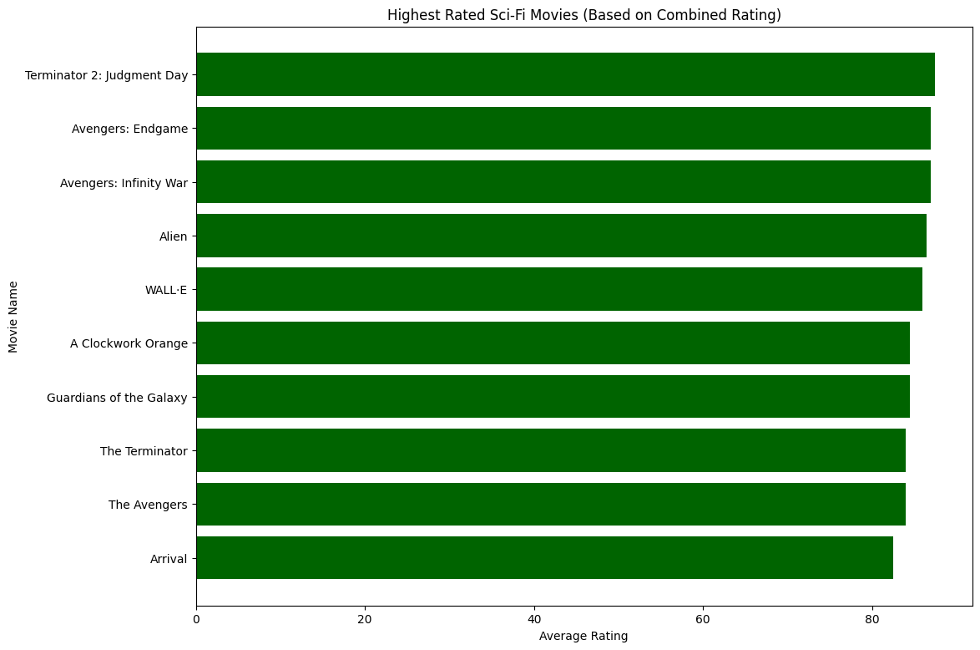
Highest Rated Sci-fi Movies Based on Combined Rating.

Slide 4
This list has some solid movies.
I have unfortunately watched about half of these movies, so I plan on avoiding the others.

Slide 5
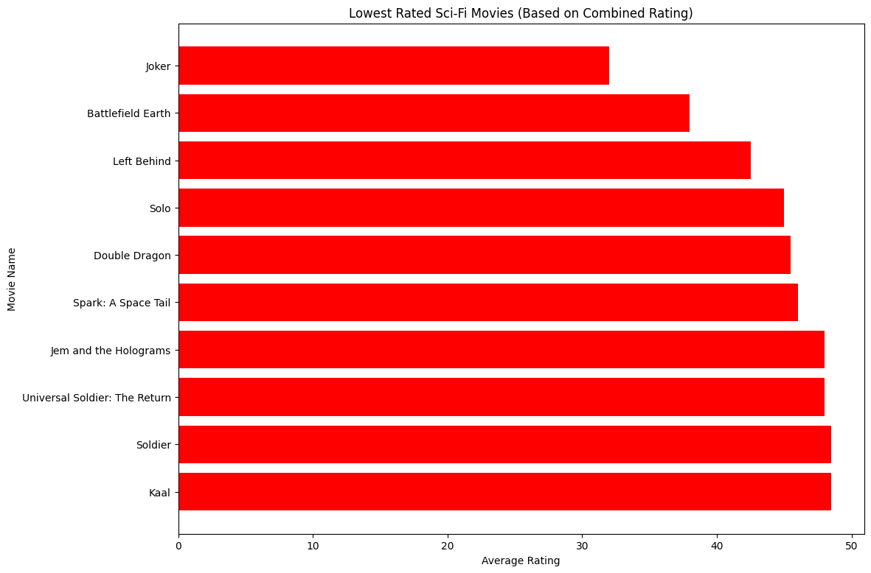
Lowest Rated Sci-Fi Movies Based on Combined Rating

Slide 6
I was surprised to see some of these movies listed with the lower ratings.
I have seen all of these movies except Clockwork Orange.

Slide 7
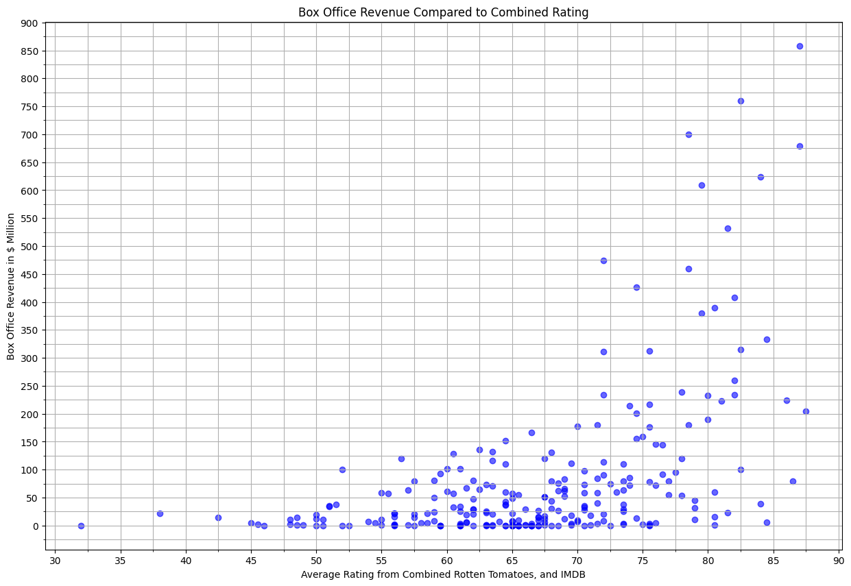
Box Office Revenue as Related to Combined Ratings

Slide 8
I assumed that the better movies would have a higher box office return. I have in the past watched a movie in the theater 2-3 times. I’m curious to know if that is normal behavior.

Slide 9
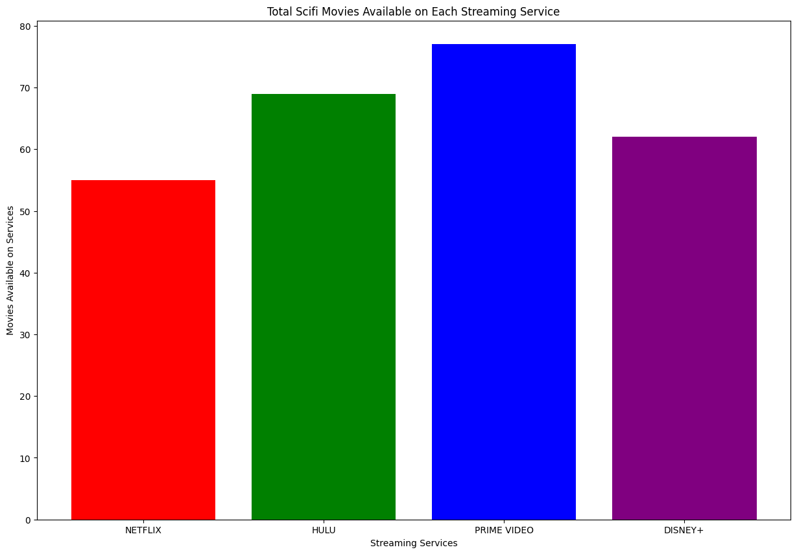
Total Quantity of Sci-Fi Movies on Each Streaming Service

Slide 10
Based on this data and personal experience, I agree that Amazon Prime is the best source for Sci-Fi movies.

Slide 11
Conclusion
After completing this analysis, I feel that I accomplished my goals.
Future analysis should be performed to determine the following:
Are some movies available on more that one streaming service?
Could I determine the average Quality of the movies on each service?
Could I find data that returns the cost per movie to compare with ratings and box office revenue?

